Slide 1
INTERACTIVE ROBOTICS: METAMATERIAL SENSORS
Group II Members: Johannes Kahlen, Rifat Rahman Turjo

Slide 2
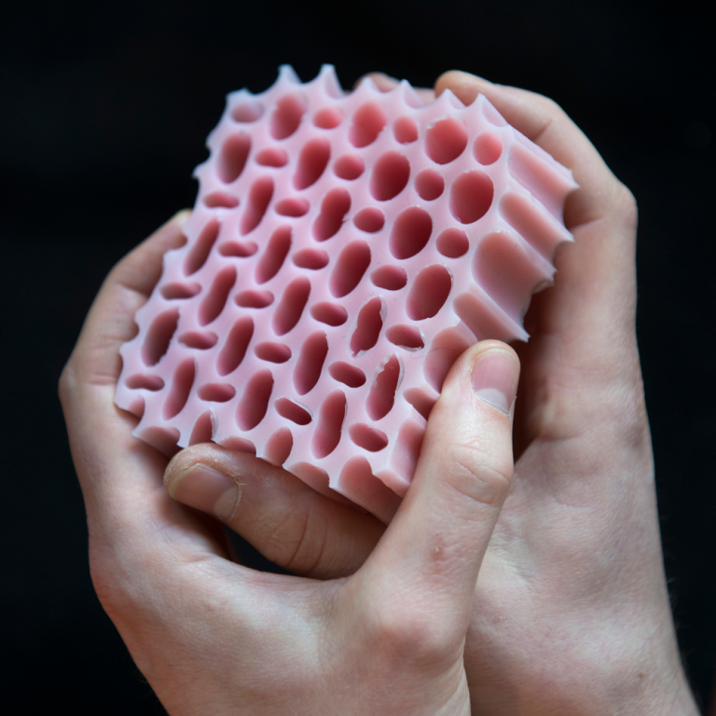
What Are Metamaterials?
Unique structures
Properties based on geometry
Cell designs enable :
Shape change
Shock absorption
Wave propagation
Localized elasticity
Ion, et al. Interactive Metamaterials, interactions.acm.org,2020, vol. XXVII

Slide 3

Motivation: Metamaterial Sensing
Using capacitive-based sensing to design a accelerometer
(a) visualization of the signal
(b) fabricated accelerometer
(c) Using two electrodes that share one ground connection.
Gong, et.al. MetaSense: Integrating Sensing Capabilities into Mechanical Metamaterial, UIST ‘21

Slide 4
Motivation: Metamaterial Sensing
Sensing capability integration into 3D printed metamaterial structures
Leads to the invention of monolithic HCI input devices
Design of a sensor to process structural deformation as input to estimate physical quantities as tangible outputs (e.g. compression force, deformation angles)
Gong, et.al. MetaSense: Integrating Sensing Capabilities into Mechanical Metamaterial, UIST ‘21

Slide 5
Motivation: Metamaterial Sensing
The conductive cell walls of MetaSense objects act as capacitance sensors to detect user interaction.
A Metasense joystick is shown in (a) original state and (b,c) deformed states during user interaction with capacitance changes of conductive shear cells detected accordingly.
Gong, et.al. MetaSense: Integrating Sensing Capabilities into Mechanical Metamaterial, UIST ‘21

Slide 6
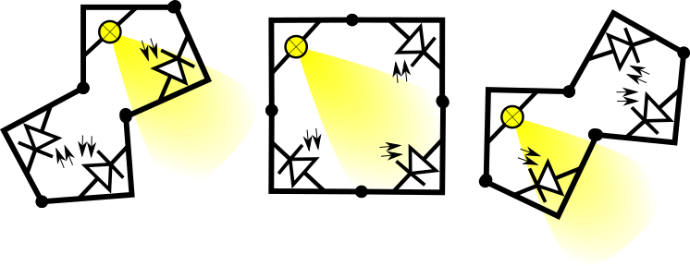
Metamaterial Light sensor
Ideas on how a deformation sensing basic cell could be build (using the kinetiX basic cell)
Light Sensing: Pulse light to calibrate sensors to environment
between each measurement (best use fast, irregular pattern to minimize interference).
Ou et al., KinetiX - designing auxetic-inspired deformable material structures, CG '18

Slide 7
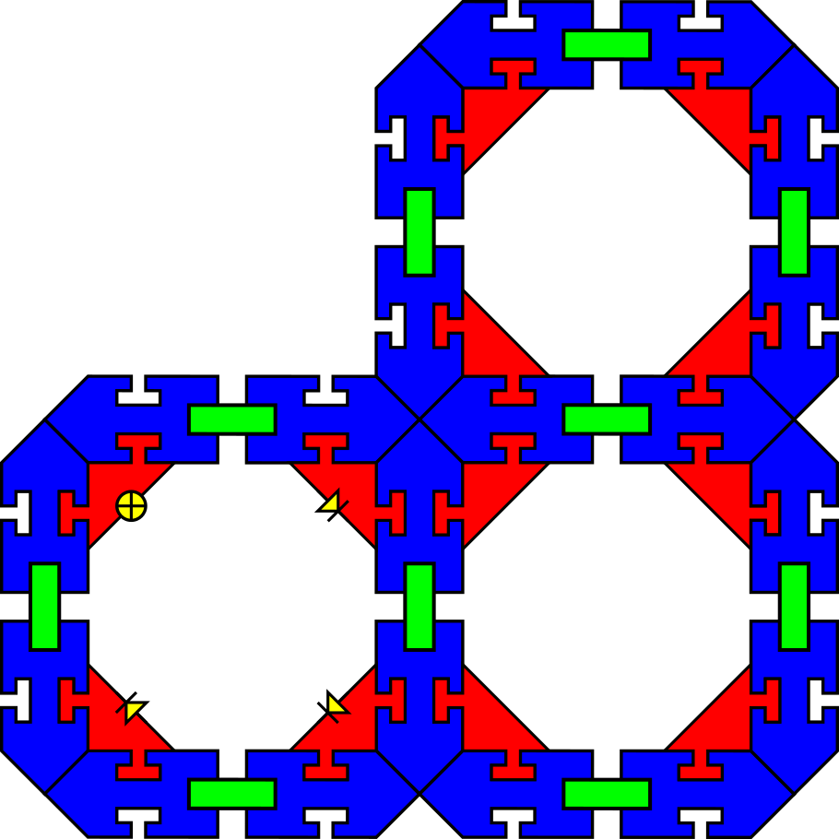
Cell Structure
Geometry enables deformation of single cell to be mimicked across adjacent cells
Blue – Cell wall structure(PLA)
Green – Linkage structure (TPU)
Red – Notched sections to mount electronic components

Slide 8

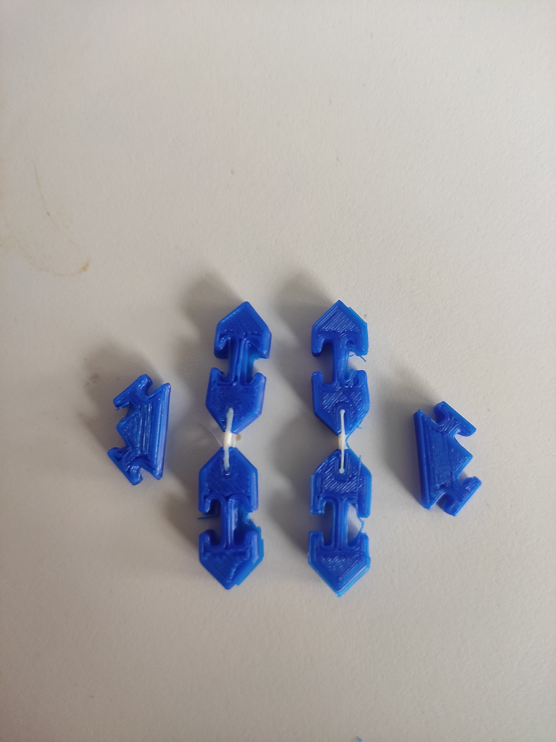
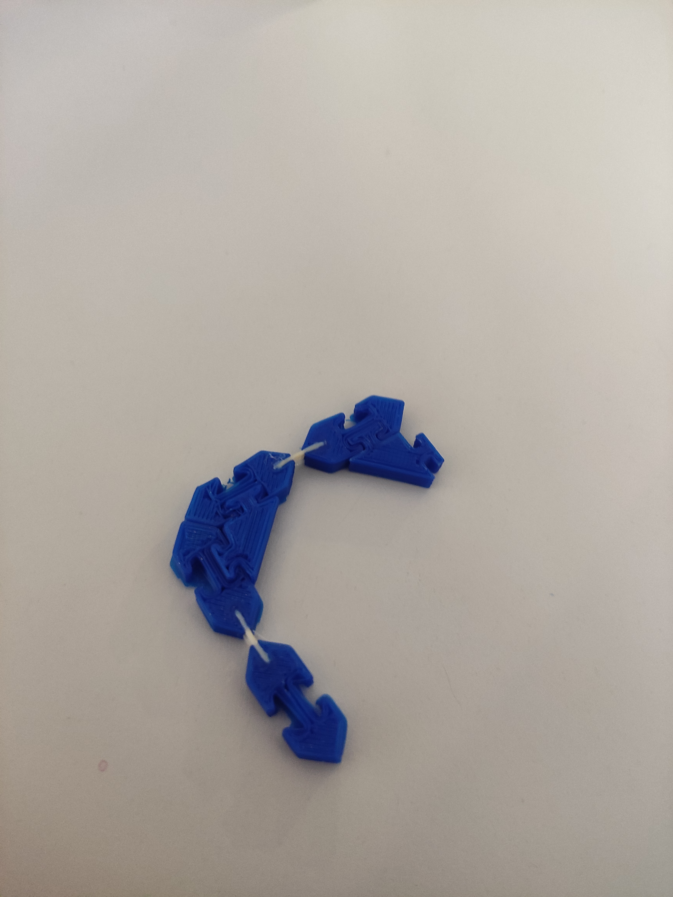
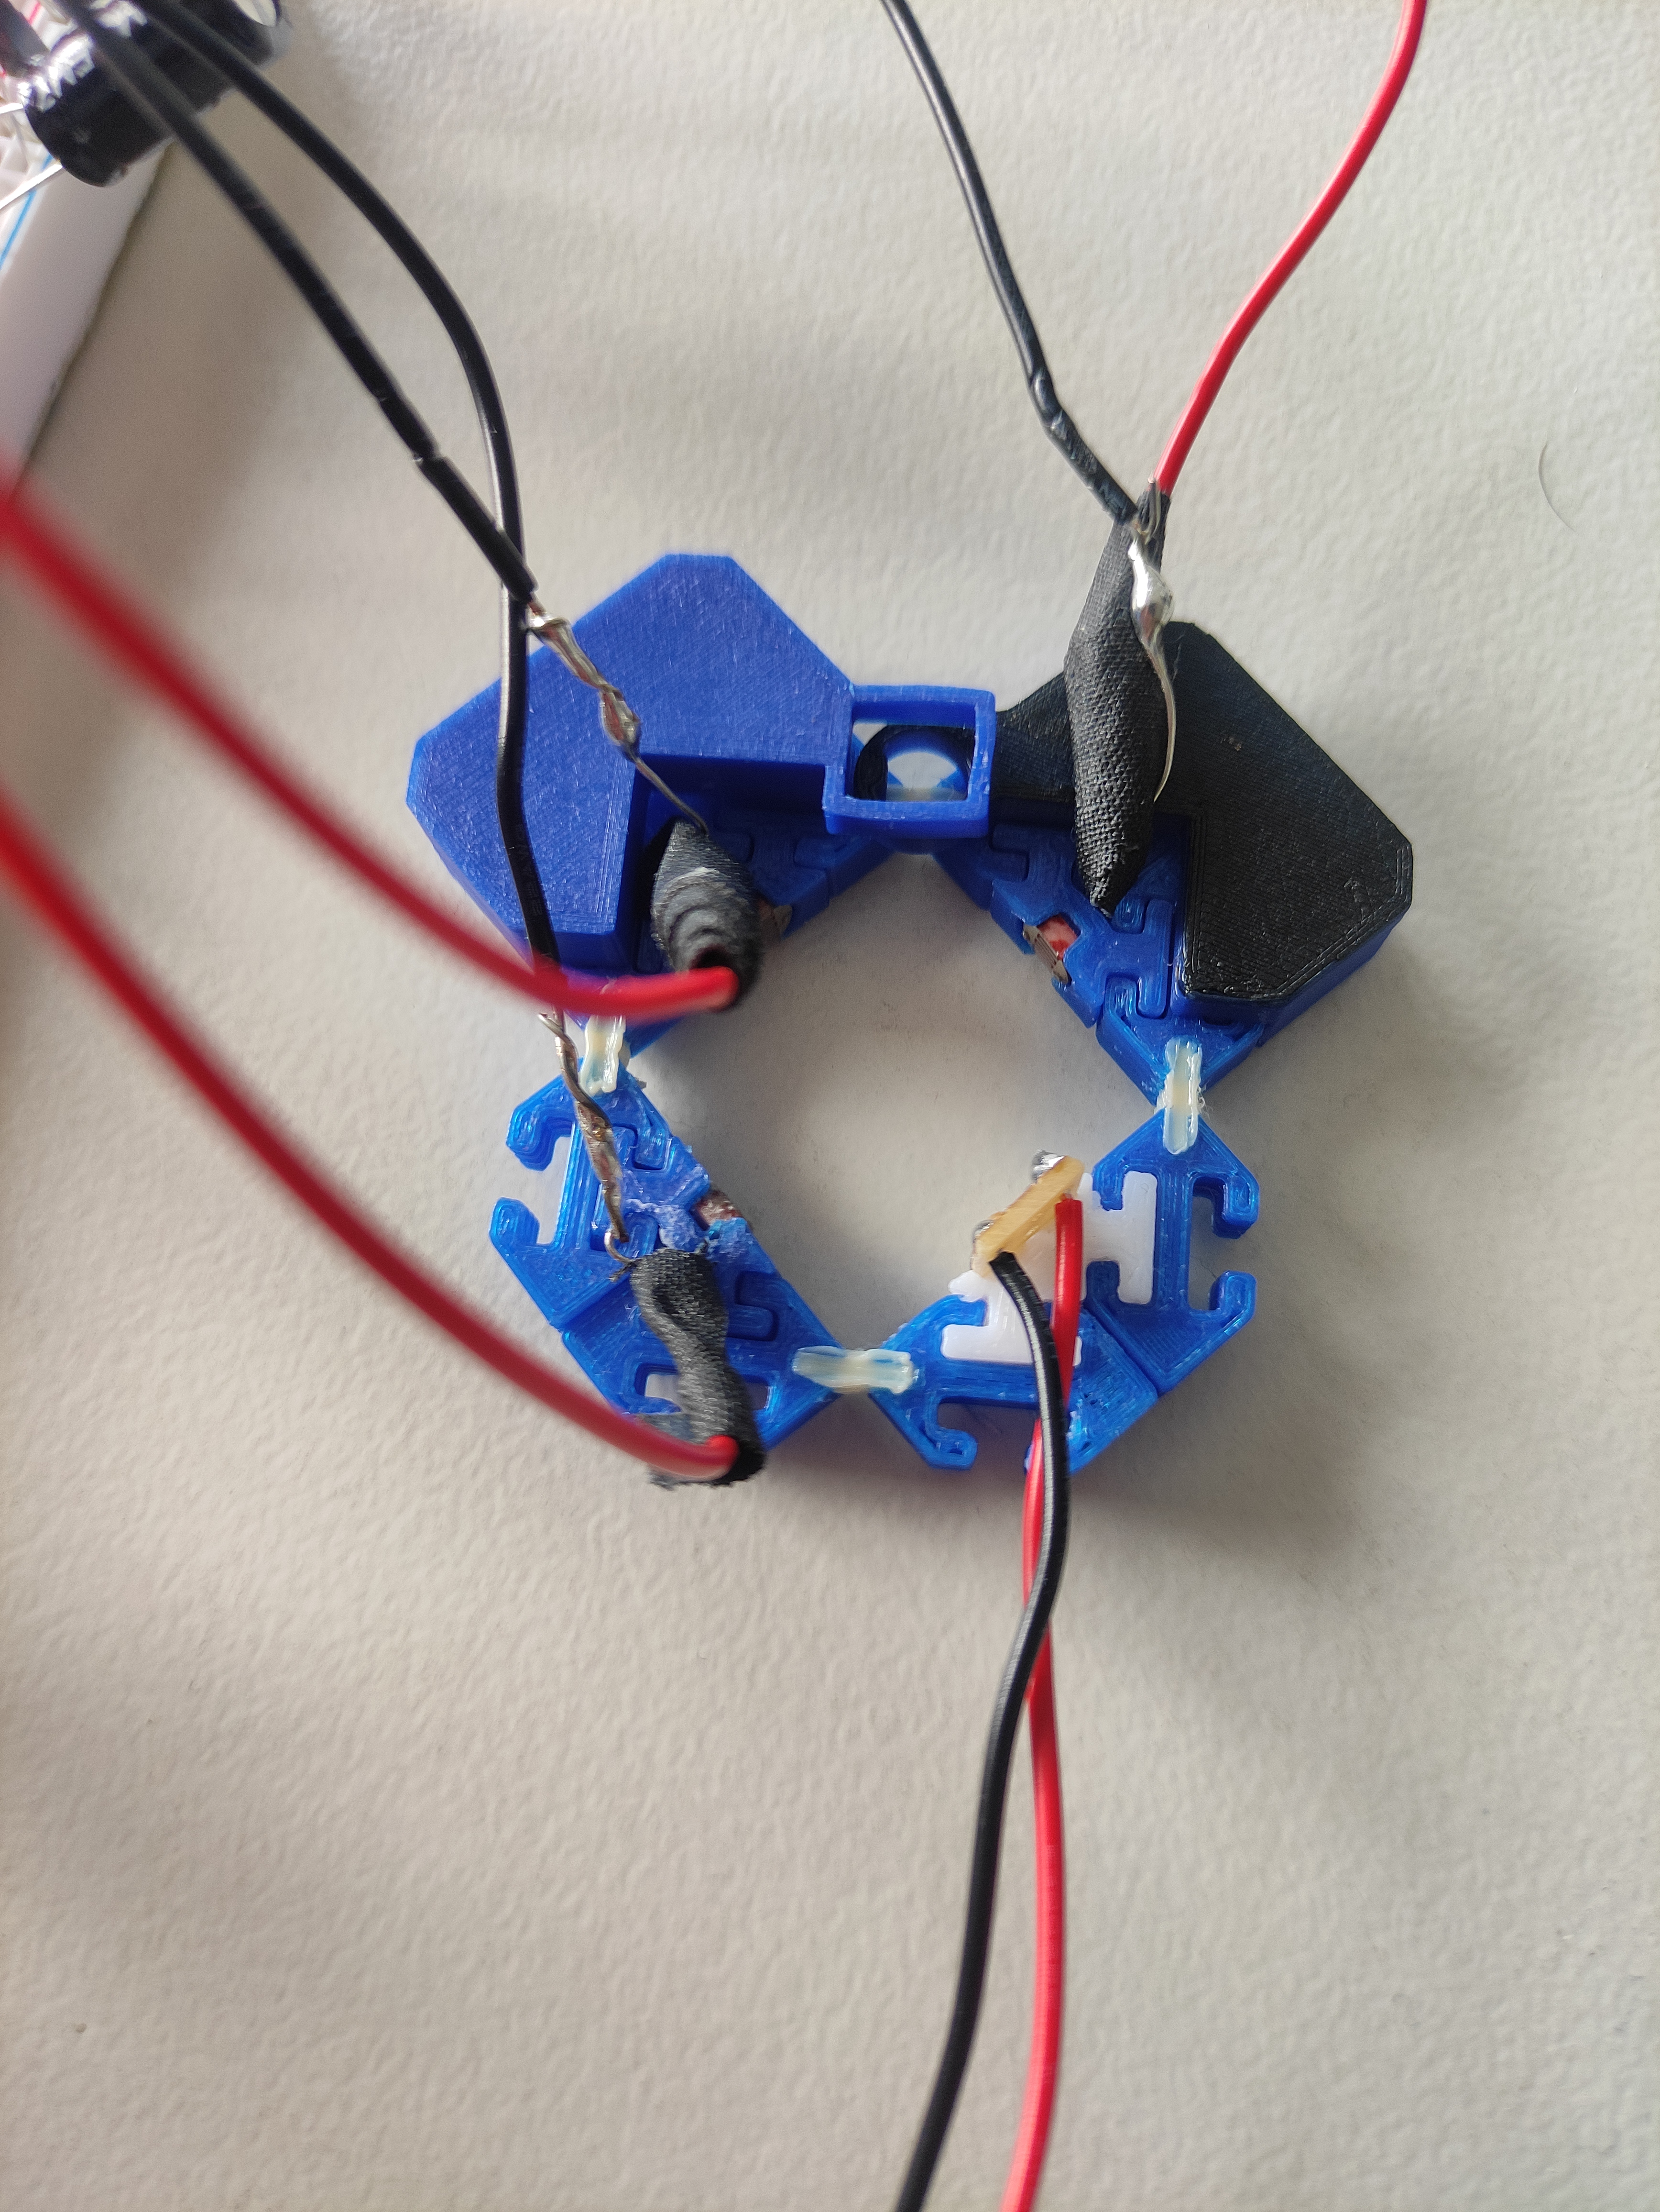

Design and Assembly

Slide 9
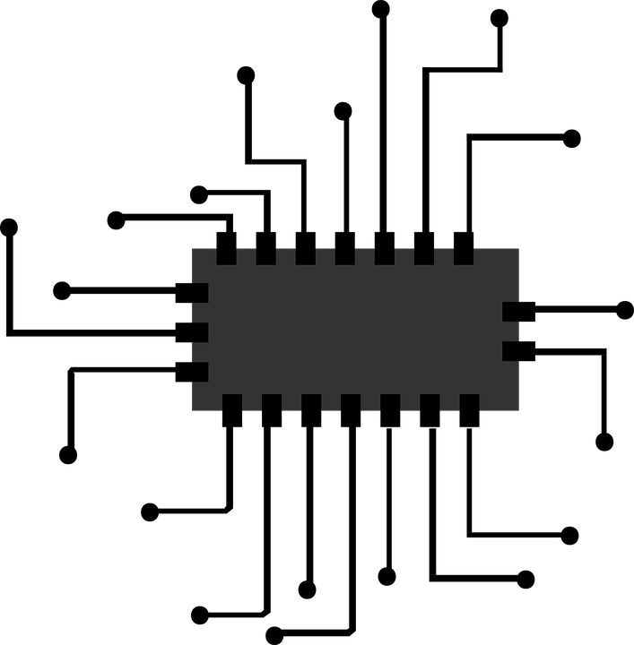
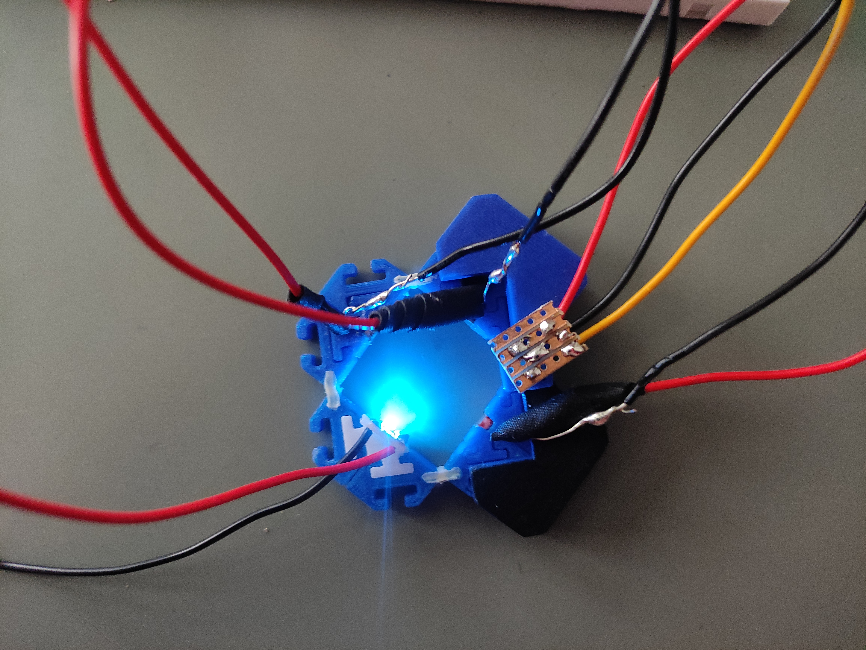
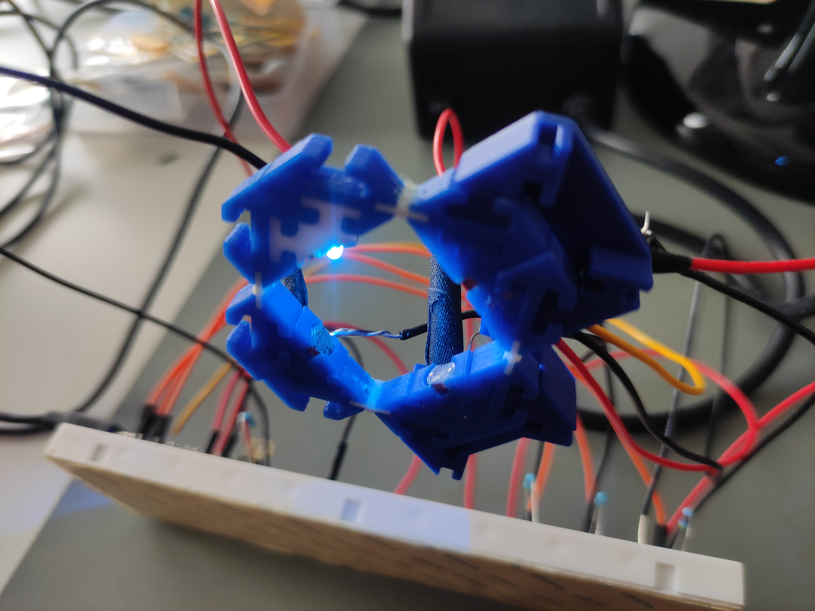
Prototype

Slide 10
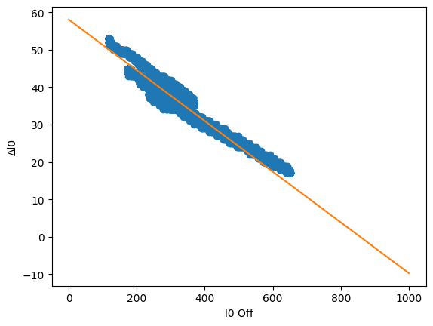
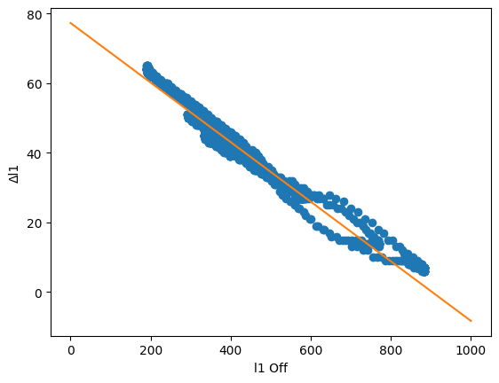
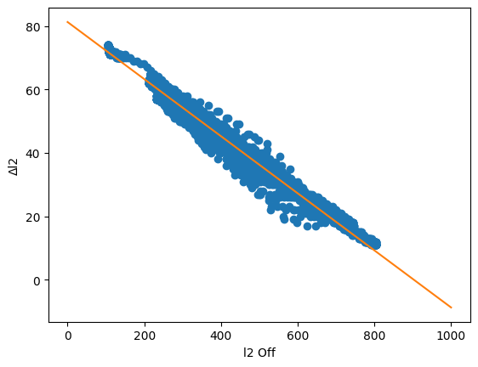
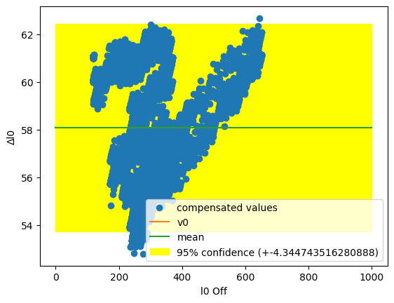
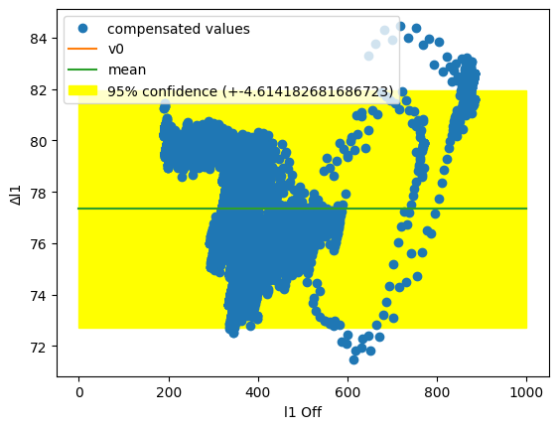
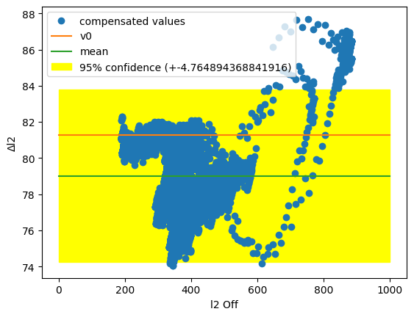
Data Analysis
Without
Compensation
With
Compensation
LDR 0
LDR 1
LDR 2

Slide 11
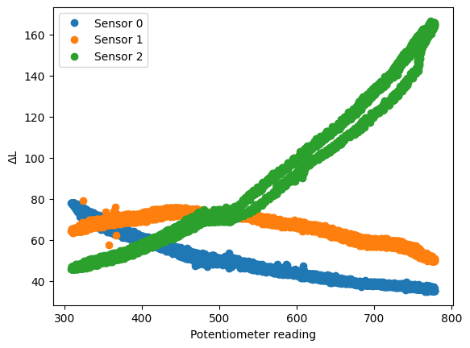
Deformation Calibration

Slide 12
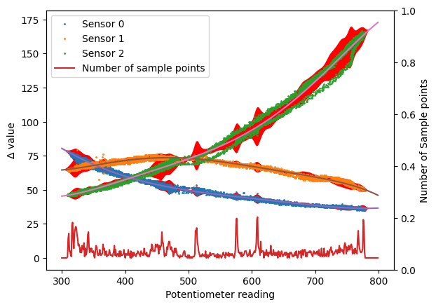
Uncertainty Around Curve

Slide 13
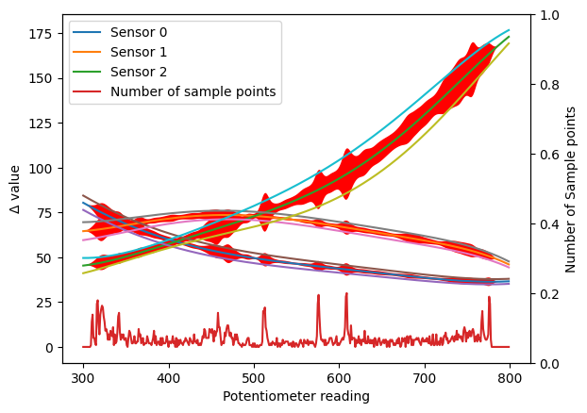
Weighted Approximate Uncertainty

Slide 14
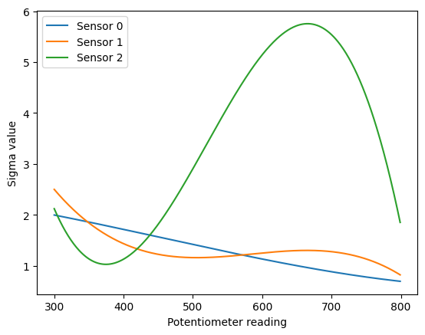
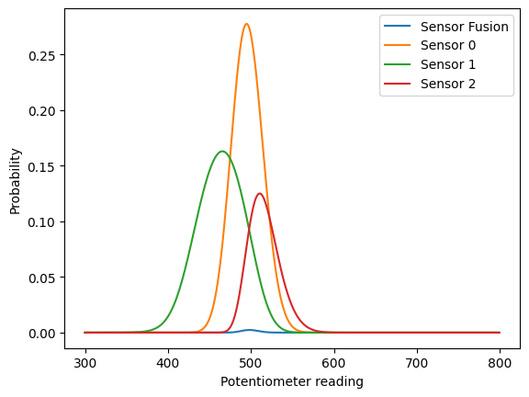
Implementation of Sensor Fusion

Slide 15
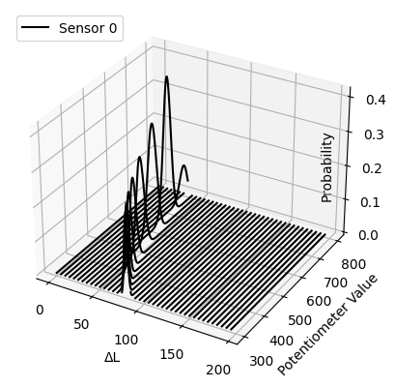
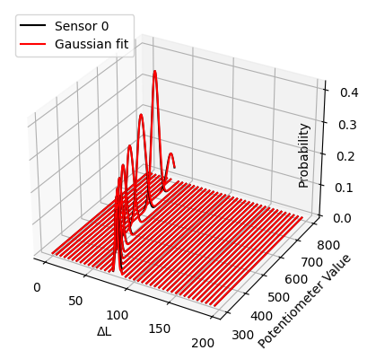
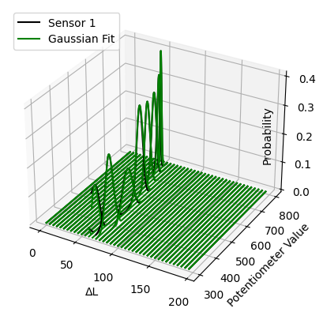
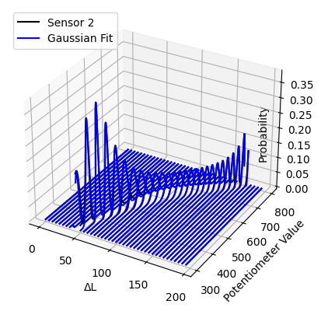
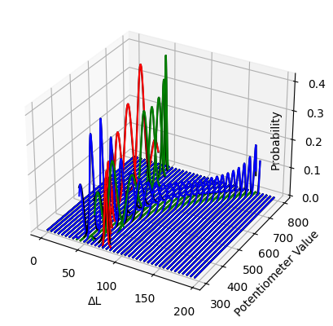
Gaussian Fit

Slide 16
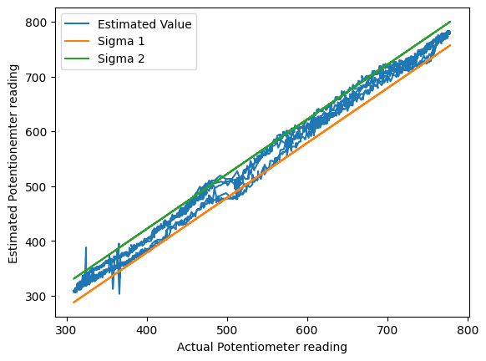
Estimated Potentiometer Readings
2 sigma 95%: +-21.565461787902436 => ~7.763566243644877deg

Slide 17

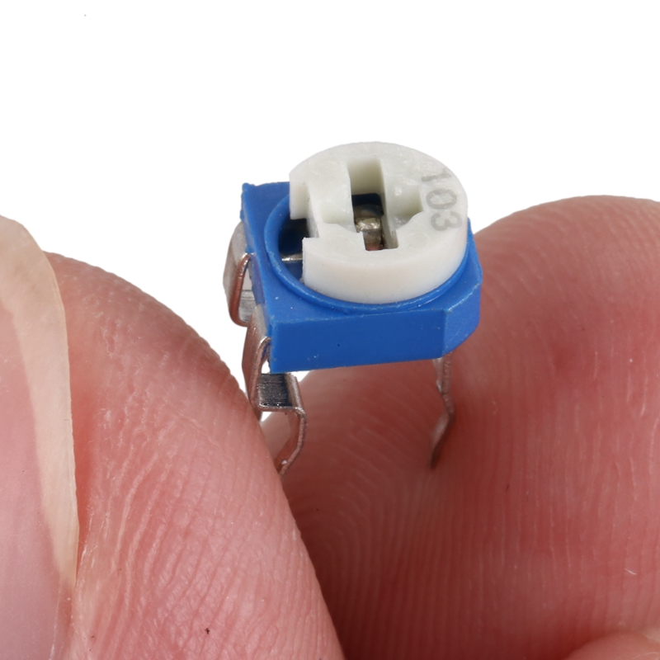
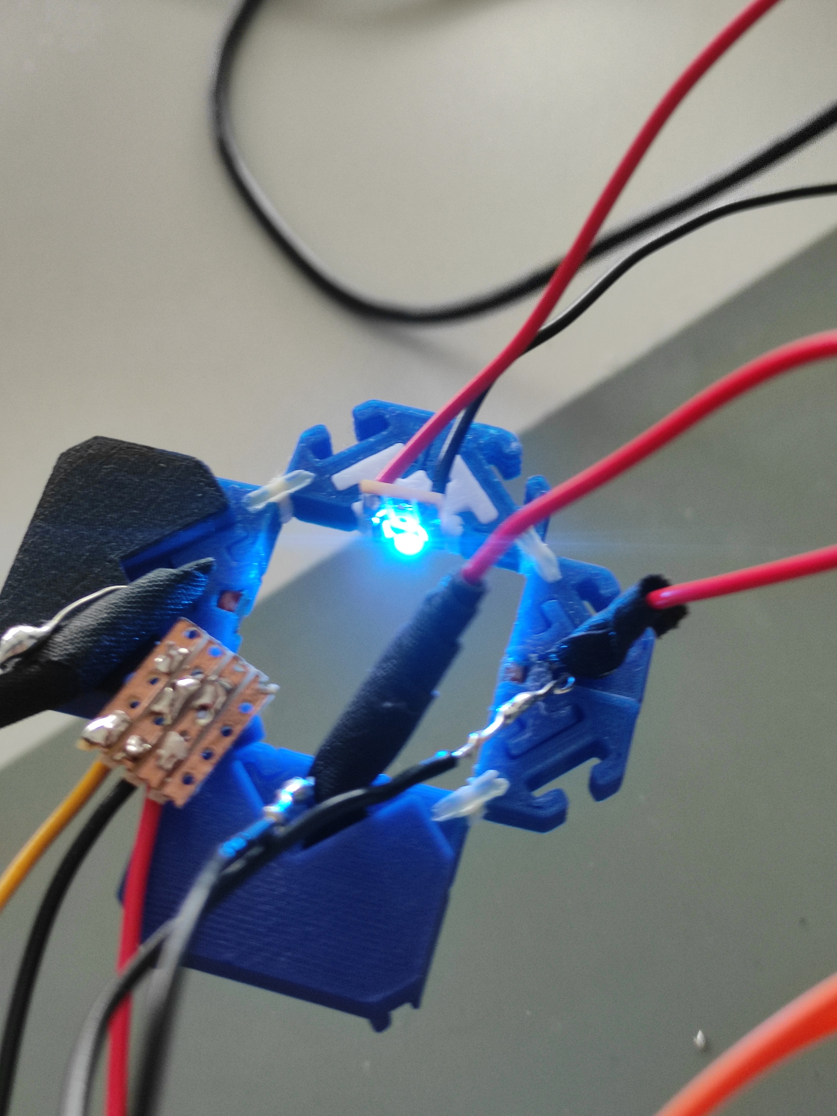
Challenges
Cell structure design modified to include a potentiometer
Potentiometer’s mechanical nature posed certain limitations
Sometimes resulted in sensors producing more reliable output than potentiometer

Slide 18

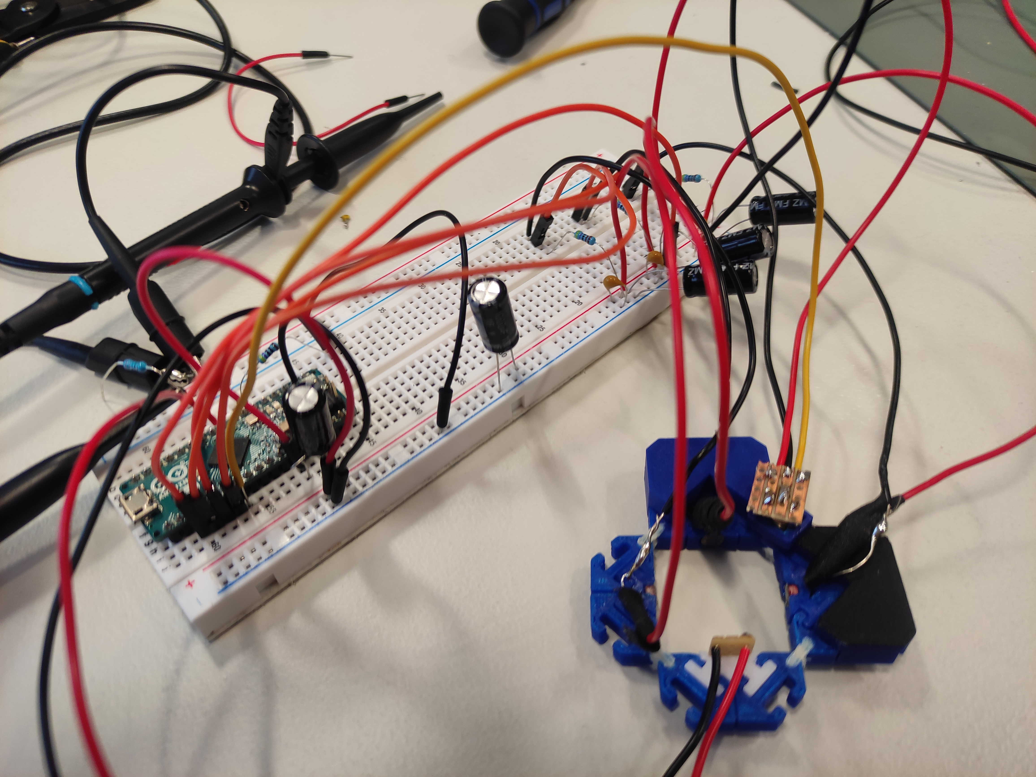
Future Scope
Improve cell structure design to better incorporate SMD components while maintaining the modular aspect
Implementing a different potentiometer or more suitable component to obtain a ground truth reading

Slide 19
THANK YOU

